Slide 1

Tableau & R Integration: Create Interactive & Dynamic Analytics
2019 AIR Forum
Sinji Yang, Ph.D.
College of Literature, Science, and the Arts
University of Michigan

Slide 2




Tableau: “I am the mighty Iron-Viz warrior.” R: “shhh…. Show me what you have.”

Slide 3


Comparison: Tableau vs. R
However, Markdown & Flexdashboard can let you create dynamic reports with R.
Features | Tableau | R
Data Visualization | Dynamic Interactive User-friendly Drag & drop | Static Not interactive Not user-friendly Spaghetti codes
Statistics | Limited Basic descriptive stat. Trend line (simple regression) | Abundant Various advanced stat. packages
Functions | Limited sets Limited flow controls No looping & iteration Vectorization (? Not sure) | Various functions plus Iterative functions Matrix manipulations User-def. functions Vectorization

Slide 4
Tableau & R – After the Integration
R allows Tableau to do advanced statistics that Tableau cannot usually do. R can create special data points to achieve visual effect in Tableau
Tableau can visualize R analytics interactively and dynamically
The well-designed R script can run statistics for different data measures, sub-groups, dimensions, or answer a set of scenario questions without modification.

Slide 5
Tableau & R – After the Integration (cont.)
Complicated and iterative calculations can be handled by user-defined functions in R.
Tableau’s data Scheduler can retrieve a new dataset and make new R analytics immediately available.
IR professionals become more productive because the integrated reports are more efficient, versatile, convincing, and promote greater usability.

Slide 6
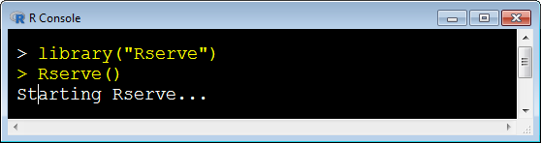
How to Integrate with R
Download & Install R https://cran.r-project.org/
Run R Console RGui.exe
Install Rserve > install.packages("Rserve")
Load Rserve > library("Rserve")
Start Rserve > Rserve()
To auto-load Rserve package, add
to the end of
[R install folder]\etc\
Rprofile.site
File.
library(Rserve)
.First <- function(){
cat("Rserve library has pre-loaded. Enter Rserve() to start.\n")
}

Slide 7
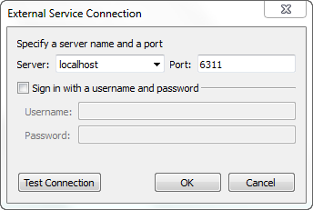
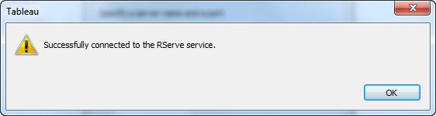
Connect Tableau to Rserve
On Tableau Desktop,
Help > Settings and Performance > Manage External Service Connection
Assuming Rserve is running on the local PC (i.e., localhost) with default port # = 6311

Slide 8
I now pronounce you husband and wife

Slide 9
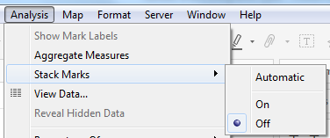
Configure Tableau Worksheet to Use R Script
Analysis > Aggregate Measures un-checked
Analysis > Stack Marks > Off
un-checked
Alternative: For returning only one value,
Stack Marks > On and IF FIRST()=0 THEN SCRIPT_REAL('insert R script here') END

Slide 10
Script Functions in Tableau
Function | Input | Output | Example
SCRIPT_INT() | any | Integer | 520, 1314
SCRIPT_REAL() | any | Real | 1.41421, 3.14159
SCRIPT_STR() | any | String | AIR 2019, Denver
SCRIPT_BOOL() | any | Boolean | true or false

Slide 11
Aggregate Functions in Tableau for R Script
Script argument(s) | Acceptable Argument Type
must be aggregated | Numeric | Categorical
SUM() | ☺ | No
AVG() | ☺ | No
MEDIAN () | ☺ | No
MAX() | ☺ | ☺
MIN() | ☺ | ☺
COUNT() | ☺ | ☺
ATTR() * IF min = max THEN min ELSE ‘*’ END | ☺ | ☺
It doesn’t matter which function is used in R script, outcomes are the same. Cannot sum, average, or get median of categorical variables. * Slower

Slide 12
Tableau R Script Syntax
Either single- or double-quotation marks is fine. However, single quotes are preferred because double quotes are often used in R code.
SCRIPT_XXX (
‘
Put your R script here. Input variables are as .arg1, .arg2, .arg3, etc.
Script can be in multiple lines and steps
Put the returning value(s) at the last line
’
, SUM([ Variable 1 ])
, MAX([ Variable 2 ])
, ATTR([ Variable 3 ])
… # more input variables (or arguments)
)
Quote the R code
as a string
Input Parameters

Slide 13
A Simple R Script Example
// Create an array of normally distributed random numbers
// using rnorm( size, mean, sd ), store them in variable x
// then add x to the input variable.
SCRIPT_REAL(
“ x <- rnorm( length(.arg1), mean=5, sd=10)
# use length(.arg1) to avoid specifying a static size
.arg1 + x # this array of values will be returned to Tableau
“
, SUM([MATH])
)

Slide 14
Demo
Do a simple R calculation -- Add a random jitter to the MATH score
Do a t Test -- Is there a significant difference between Public and Private school ACT scores?
Run a simple regression -- Regress ACT on MATH
Examine the regression residuals distribution
Interact and visualize a t Test of gender difference in Math scores
Make input variables dynamic
Visualize a K-means Cluster Analysis
Create a dynamic dashboard with Tableau and R analytics
The data used in this demo was randomly or purposefully created. The statistical results may not align with reality.

Slide 15
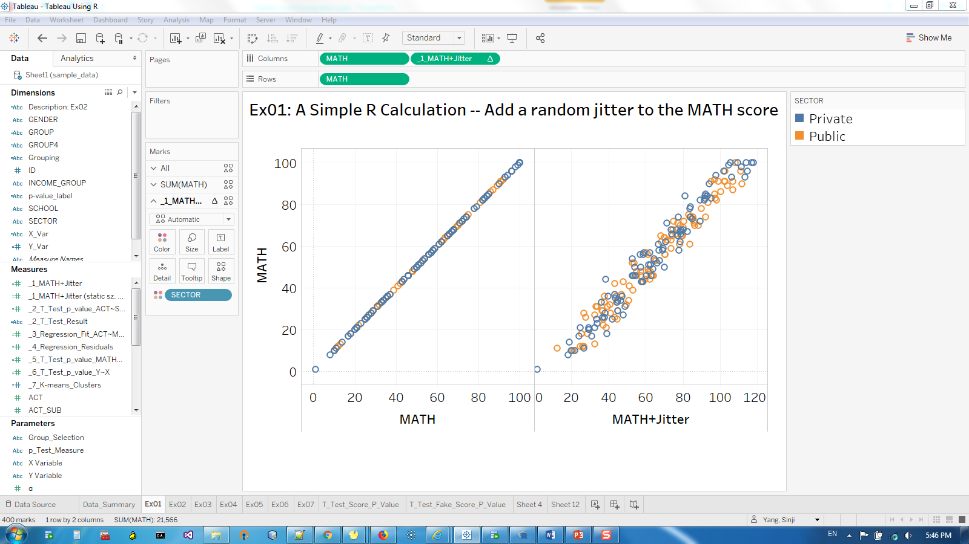

Slide 16
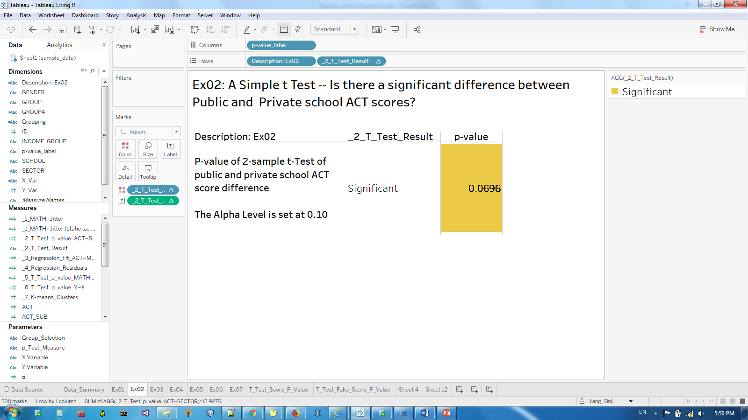

Slide 17
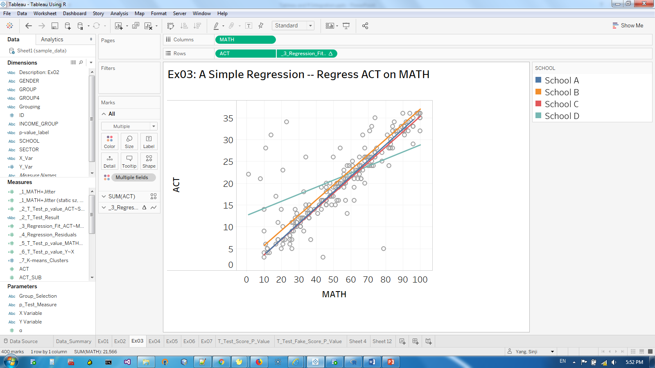

Slide 18
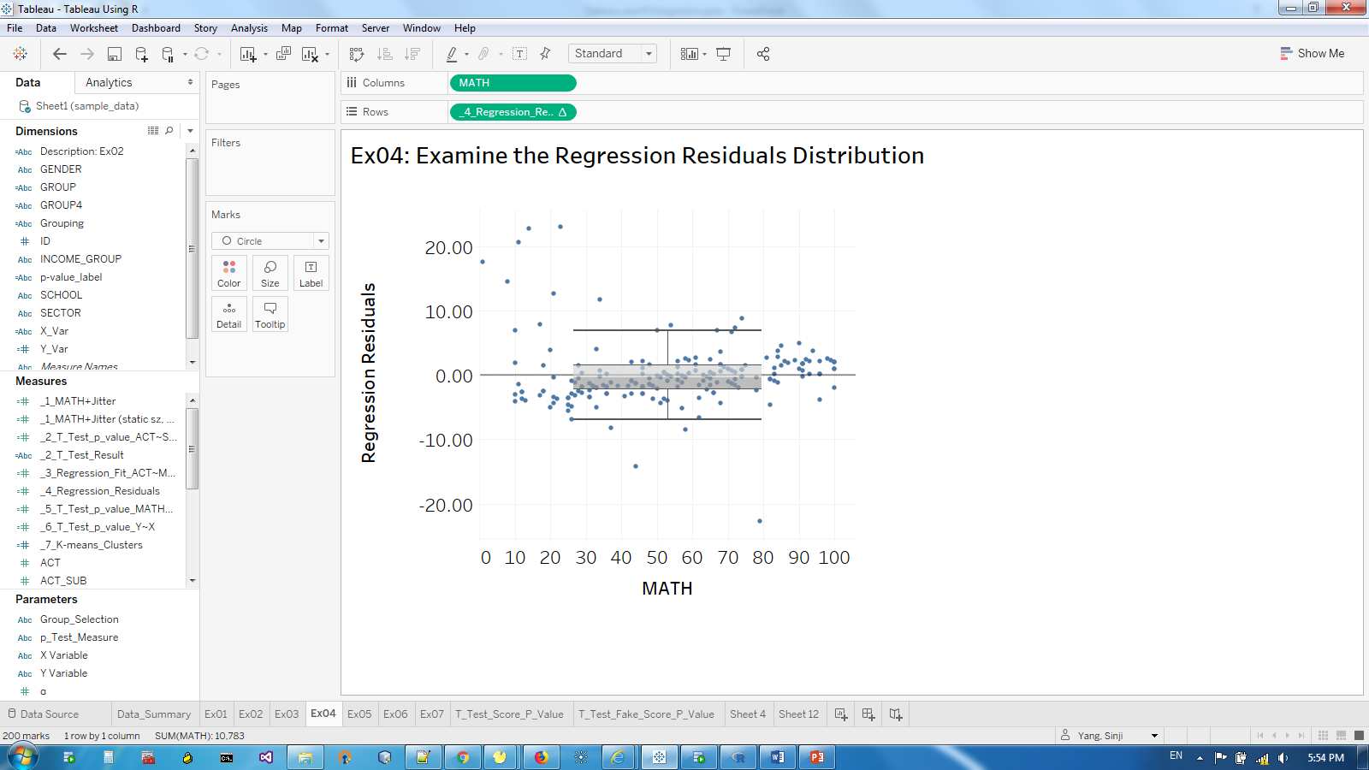

Slide 19
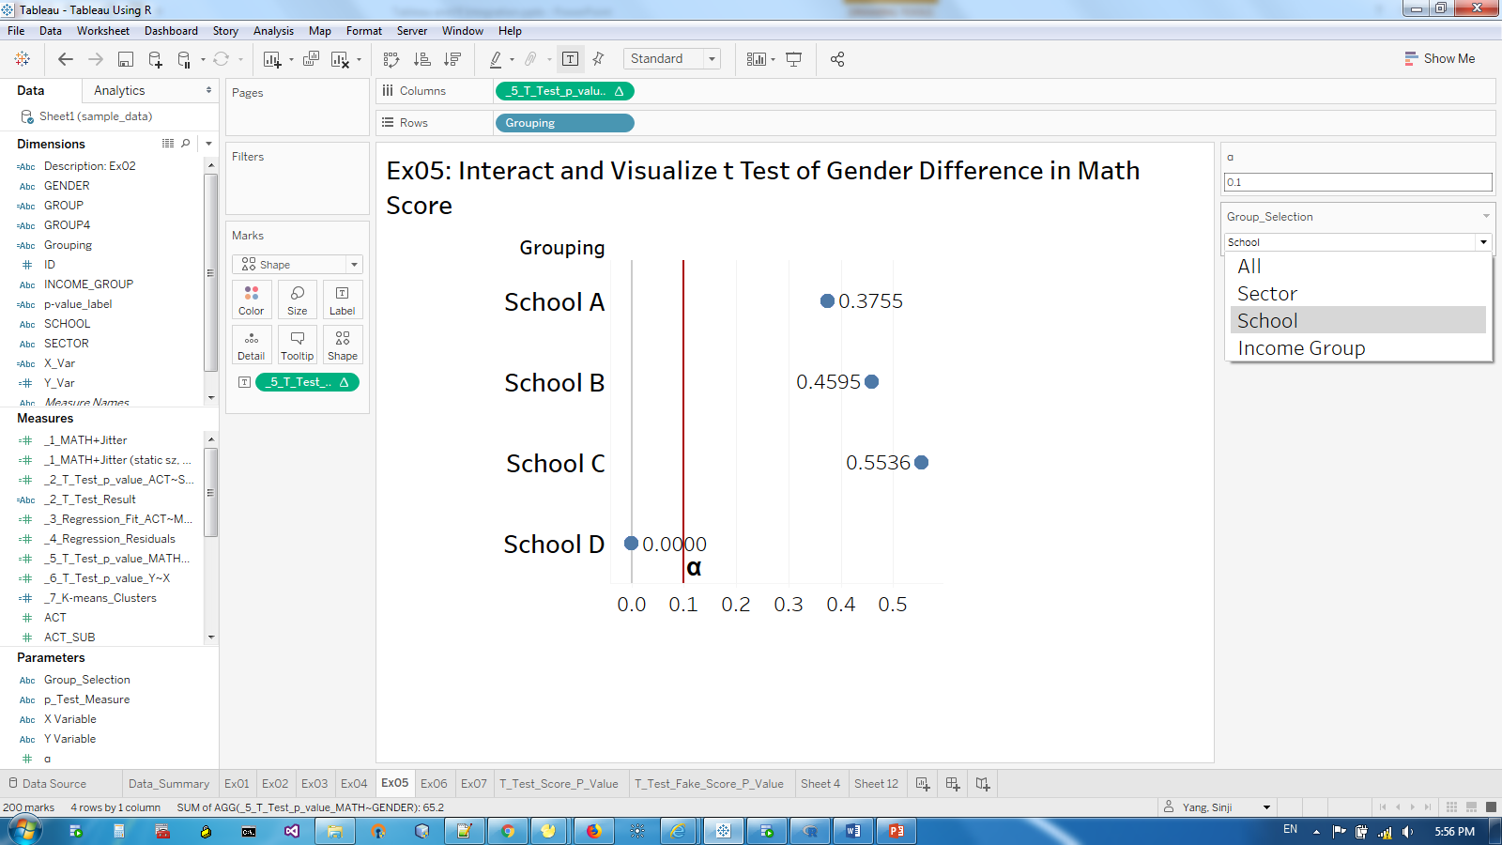
Users can choose how to dice the data, and see gender difference of various sub-groups.

Slide 20
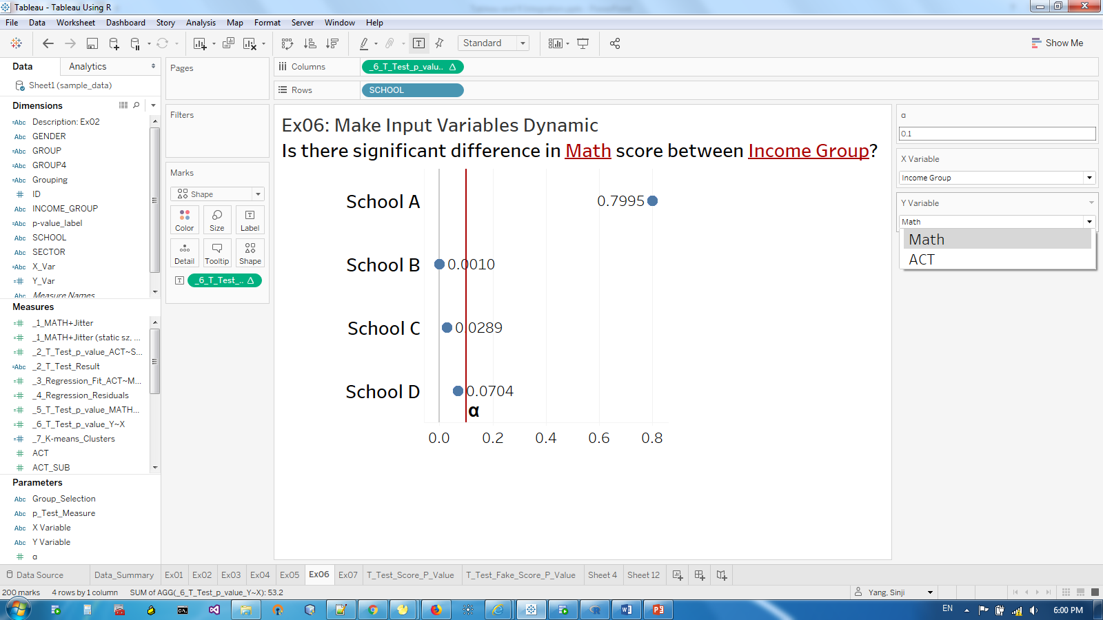
Users can choose which measure (e.g., ACT or MATH) to do a t-test, or choose a different grouping variable.

Slide 21
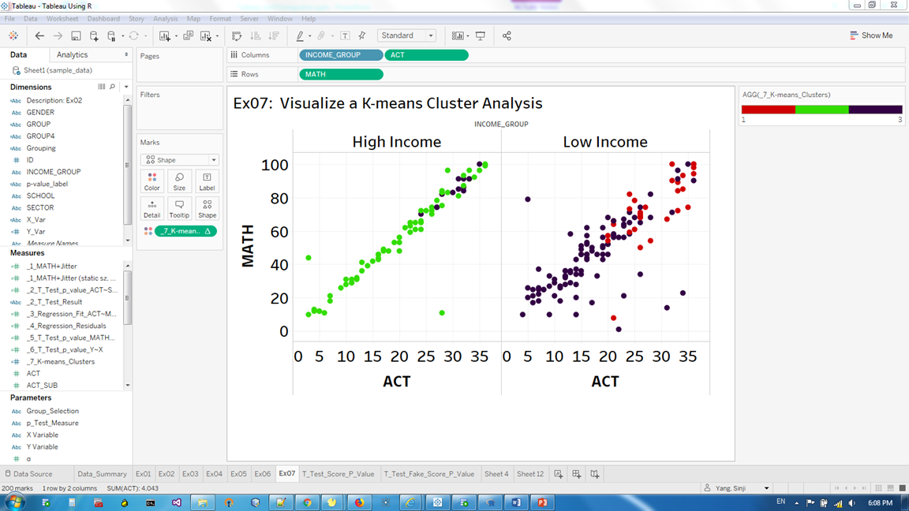
3 Clusters
Group 1
Group 2
Group 3

Slide 22
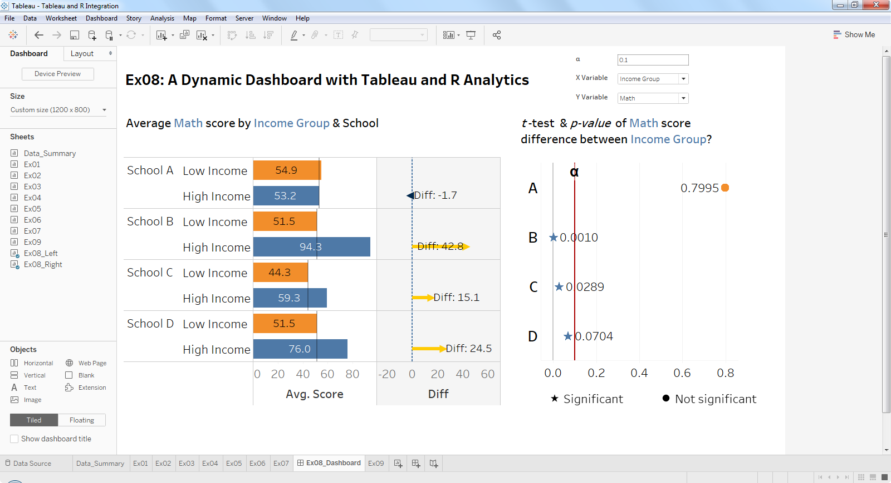

Slide 23
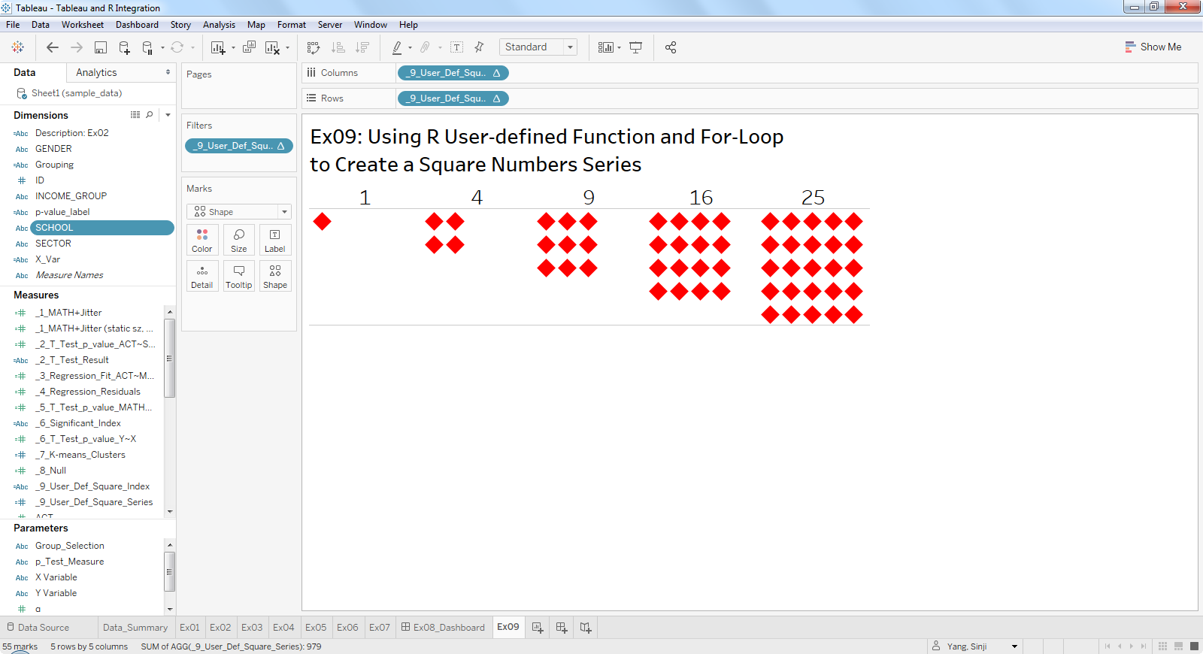
// Use a user-defined iterative function in R
// to create a special visual effect in Tableau
SCRIPT_STR( ‘ source("myLoop.R")
square_index( length(.arg1) ) ’
, ATTR([ID]) )

Slide 24

Troubleshooting

Slide 25
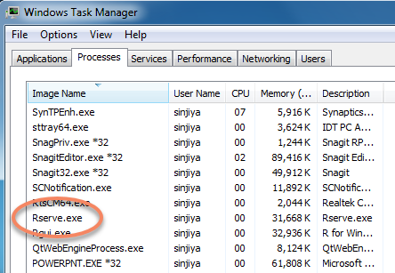
Is Rserve Running?
Check the Rserve connection in Tableau, Manage External Service Connection,
or
check it in the Windows Task Manager

Slide 26
Check for Common Mistakes
On the worksheet, the Analysis > Aggregate Measures is not set to un-checked
The Analysis > Stack Marks is not set to OFF
In the R script (Calculated Field), arguments are not aggregated
Errors in the R code writing: e.g., quotation marks are not paired properly.

Slide 27
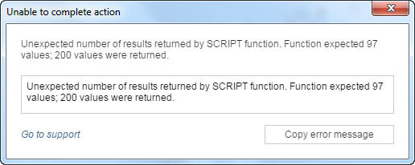
Wrong Size of the Returning Data
The returning value(s) should be size of one or the same size as the input variable.

Slide 28
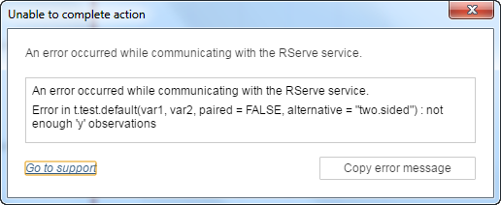
Not Enough ‘y’ Observations for R
When you slice and dice your Tableau data into too small pieces
Tips: Here is a pseudo code for you when you dynamically filter your data. In your R code, use
if (length of group1 > 0 && length of group2 > 0 ...etc ) { run the code and return the result }
else { return -9999} Make Tableau watch out for the potentially bad values -9999.

Slide 29
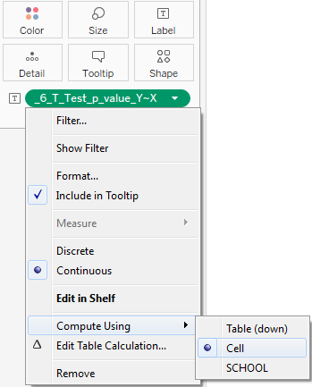
The R statistic seems incorrect. Help!
Check the Calculated Field’s table calculation Compute Using setting to correct the problem.

Slide 30
Conclusion
It is a win-win integration of Tableau and R.
Tableau and R integrated report can help IR professionals take care of the recursive R analytics needs.
A Checklist of Tableau and R Integration processes/steps would help avoid common mistakes.
Be organized with the Tableau R script.
Documenting and commenting the R script in the calculated fields can help you and other developers maintain the integrated reports easier.

Slide 31
Q & A
Contact Information:
Sinji Yang, Ph.D.
sinjiya@umich.edu
Sr. Business Intelligence Analyst
College of Literature, Science, and the Arts
University of Michigan

Slide 32
Reference & Resources
Tableau and R Integration
https://community.tableau.com/docs/DOC-5313
Rserve
https://www.rforge.net/Rserve/doc.html
R for Statistical Computing & Analysis
https://www.tableau.com/solutions/r
Dream Team – combining Tableau and R
https://www.r-bloggers.com/dream-team-combining-tableau-and-r/
Vectorization in R: Why?
http://www.noamross.net/blog/2014/4/16/vectorization-in-r--why.html
10 things R can do that might surprise you
https://simplystatistics.org/2019/03/13/10-things-r-can-do-that-might-surprise-you/

